Slide 1
Our Region, Your Future
The world of work in the North East
SEND Lesson
In association with VotesforSchools and The WOW Show
©VotesforSchools The WOW Show 2022

Slide 2
Learning objectives for today
Being aware that learning, skills and qualifications are important for careers.
Being aware of the range of possible jobs.
Being aware that career describes your journey through life, learning and work.
Developing the ability to communicate your needs and wants.
Being aware of rights and responsibilities in the workplace and in society.
Being aware that there are trends in local and national labour markets.
©VotesforSchools The WOW Show 2022
Notes:
Images & References
https://www.thecdi.net/New-Career-Development-Framework

Slide 3
Keywords
Labour Market Information (LMI): Information about the jobs and careers available in a geographical area.
Sector: The areas into which the economic activity of a country is divided.
Employability: Having the skills and abilities needed to have a job or career.
Career: The job or series of jobs that you do during your working life.
Labour market: The supply of people in a particular country or area who are able and willing to work.
©VotesforSchools The WOW Show 2022
Notes:
References
https://dictionary.cambridge.org/dictionary/english/sector
https://dictionary.cambridge.org/dictionary/english/employability
https://dictionary.cambridge.org/dictionary/english/career
https://dictionary.cambridge.org/dictionary/english/labour-market

Slide 4
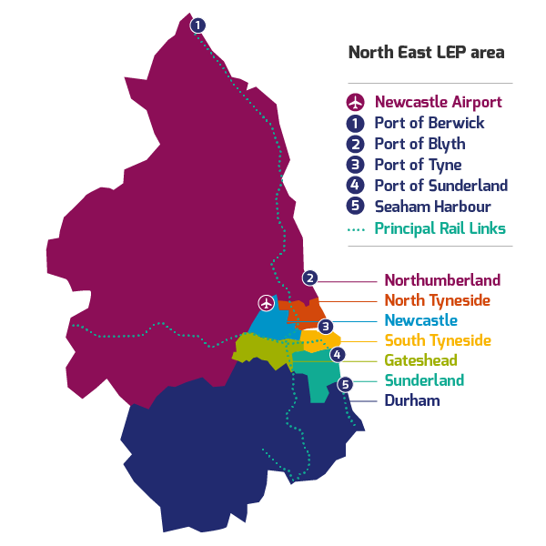
1
Where do you live?
Class discussion
Where in the North East do you live?
If you are aware of what is available in your local area it can help you decide what you could do when you leave school!
Class discussion
Which work places do you pass on your way to school?
©VotesforSchools The WOW Show 2022
Notes:
References:
http://www.lmiforall.org.uk/explore_lmi/
https://www.lmiforall.org.uk/explore_lmi/learning-units/what-is-lmi/ - There is a YouTube video explaining LMI if needed on this page.

Slide 5
2
What is Labour Market Information?
Labour Market Information (LMI) is information about which jobs and careers are available in the area.
Class discussion
Have you thought about what you would like to do when you finish school?
Labour Market Information
Information about the jobs available where you live.
©VotesforSchools The WOW Show 2022
Notes:
References:
http://www.lmiforall.org.uk/explore_lmi/
https://www.lmiforall.org.uk/explore_lmi/learning-units/what-is-lmi/ - There is a YouTube video explaining LMI if needed on this page.

Slide 6
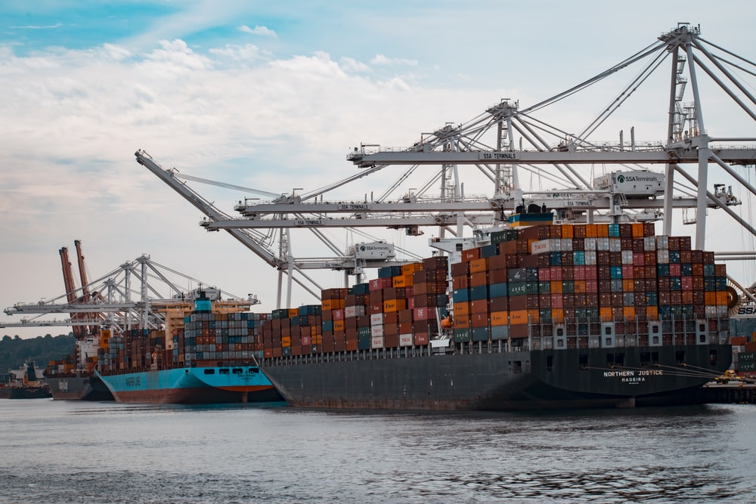
3
What is the Labour Market Information in the North East?
Class discussion
What jobs have you heard about in your area?
What jobs do your family members have?
Challenge: Have you thought about which jobs interest you?
Transport:
Transport of people and goods
Health:
Looking after people
Construction:
Building works
©VotesforSchools The WOW Show 2022
Notes:
Please Note: The North East Local Enterprise Partnership works with partners to develop a more competitive economy for the North East, Helping to create more and better jobs for everyone.
Images
Unsplash
References
https://www.northeastambition.co.uk/toolkits/labour-market-insights-toolkit
https://www.northeastlep.co.uk/key-sectors/
https://evidencehub.northeastlep.co.uk/report/gva-industry
https://dictionary.cambridge.org/dictionary/english/manufacturing
https://dictionary.cambridge.org/dictionary/english/administration
https://dictionary.cambridge.org/dictionary/english/retail
https://dictionary.cambridge.org/dictionary/english/social-care

Slide 7
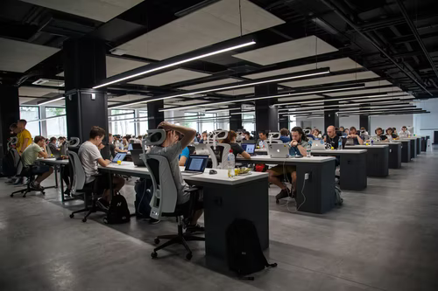
3
What is the Labour Market Information in the North East?
Shop work:
Helping out customers
Office work:
Keeping records and working on computers
Catering:
Preparing and serving food
©VotesforSchools The WOW Show 2022
Notes:
Please Note: The North East Local Enterprise Partnership works with partners to develop a more competitive economy for the North East, Helping to create more and better jobs for everyone.
Images
Unsplash
References
https://www.northeastambition.co.uk/toolkits/labour-market-insights-toolkit
https://www.northeastlep.co.uk/key-sectors/
https://evidencehub.northeastlep.co.uk/report/gva-industry
https://dictionary.cambridge.org/dictionary/english/manufacturing
https://dictionary.cambridge.org/dictionary/english/administration
https://dictionary.cambridge.org/dictionary/english/retail
https://dictionary.cambridge.org/dictionary/english/social-care

Slide 8
3
What is the Labour Market Information in the North East?
Class discussion
Have you spoken to anyone about what you want to do when you leave school?
What are you thinking about doing?
Have you heard a friend or family member talk about a job you would like to do?
There are lots of different jobs in your local area, so now you need to know how to get one.
©VotesforSchools The WOW Show 2022
Notes:
Please Note: The North East Local Enterprise Partnership works with partners to develop a more competitive economy for the North East, Helping to create more and better jobs for everyone.
Images
Unsplash
References
https://www.northeastambition.co.uk/toolkits/labour-market-insights-toolkit
https://www.northeastlep.co.uk/key-sectors/
https://evidencehub.northeastlep.co.uk/report/gva-industry
https://dictionary.cambridge.org/dictionary/english/manufacturing
https://dictionary.cambridge.org/dictionary/english/administration
https://dictionary.cambridge.org/dictionary/english/retail
https://dictionary.cambridge.org/dictionary/english/social-care

Slide 9
4
North East jobs in Transport
Transport is really important for how people get to jobs, school and leisure places as well as how we can move around goods and services.
Class activity
Click the image to watch the video and discuss any of the careers featured that you would be interested in.
0:00-2:22
The North East has lots of opportunities with buses, trains, the metro and aircraft!
©VotesforSchools The WOW Show 2022
Notes:
YouTube Video Link: https://www.youtube.com/watch?v=pVUSJl6nCJk&t=12s
SafeShare Video Link: https://safeshare.tv/x/pVUSJl6nCJk
Images:
1) Unsplash
References:

Slide 10
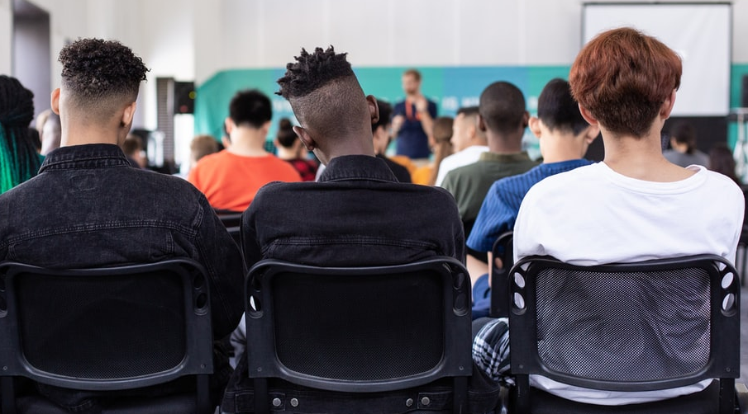
5
What is important at work?
Class activity
When you begin to look for a job or your next steps after school, what skills do you think you might need?
Click if you need a few hints!
Leadership
Being a boss
Teamwork
Working together
Problem-solving
Sorting out problems
Listening
Hearing others
Aiming High
Doing your best
Speaking
Talking to others
Creativity
Thinking differently
Staying Positive
Being happy
©VotesforSchools The WOW Show 2022
Notes:
Teacher’s Note: Many North East schools use https://www.skillsbuilder.org/ to support this area of the curriculum.
Images
Unsplash

Slide 11
6
What we say and how we hear things
Good communication skills are important for getting a job. Here are some ways to show good communication skills.
Wait for your turn to speak
Think about what is being said
Ask useful questions
Listen to all of the information
Look at the person speaking
Respect who is talking
Pair activity
Talk to a partner about how good you are at speaking and listening. Click to see some of the things you could be doing.
©VotesforSchools The WOW Show 2022
Notes:
Images
Unsplash

Slide 12
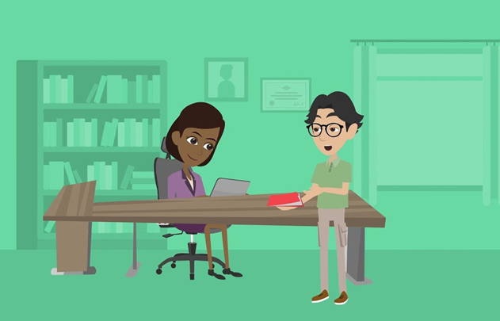
7
Why would people give you a job?
Discuss
Before you watch the video, discuss which of the skills you’ve looked at today you think you have. Do you think this makes you a good person for a particular job?
0:00-1:38
Class activity
Come up with a list of positive things about you. You can help others by telling them about a great skill you think they have.
©VotesforSchools The WOW Show 2022
Notes:
Alternative Video Link – Employability Skills: https://www.youtube.com/watch?v=tKKPUYfOkvw
SafeShare Video Link: https://safeshare.tv/x/ss602199d2bb0de
Images
1) Icons8

Slide 13
8
Things you need to do at work
Both you and the person you work for need to keep everyone safe and happy and get the job done.
Discuss
What do you think is important to do when you have a job, come up with your top three dos and don’ts.
Click for some examples if you need them.
Do dress correctly
Do turn up on time
Do the job well
©VotesforSchools The WOW Show 2022
Notes:
Images
1) Icons8
2) Unsplash

Slide 14
8
Things you need to do at work
Don’t be late
Don’t be rude
Don’t give up
©VotesforSchools The WOW Show 2022
Notes:
Images
1) Icons8
2) Unsplash

Slide 15
Thank you!
©VotesforSchools The WOW Show 2022

